Slide 1
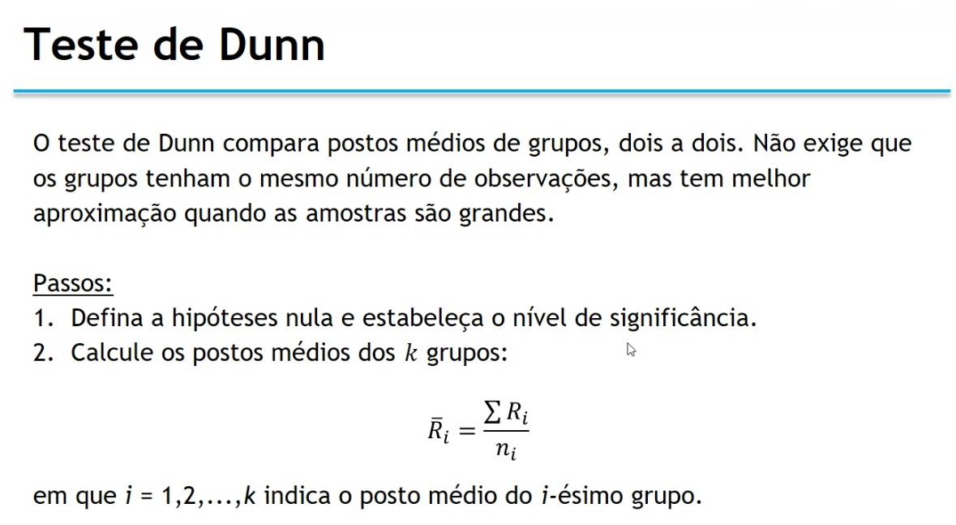

Slide 2
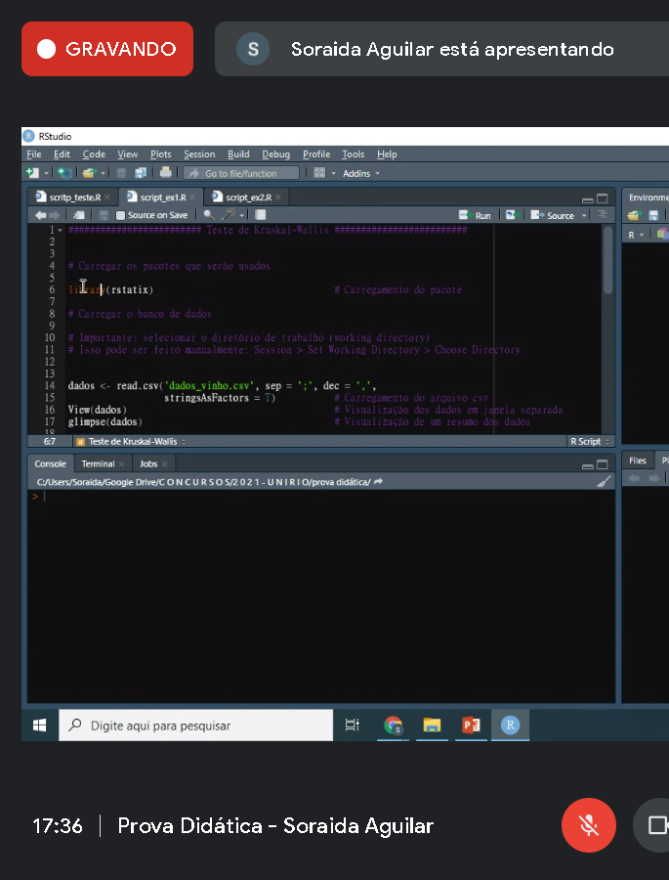

Slide 3
Use and Misuse
The Kruskal-Wallis one-way ANOVA is a non-parametric method for comparing k independent samples. It is roughly equivalent to a parametric one way ANOVA with the data replaced by their ranks. When observations represent very different distributions, it should be regarded as a test of dominance between distributions. If the original observations are identically distributed, it can be interpreted as testing for a difference between medians. If observations are also assumed to be distributed symmetrically, it can be interpreted as testing for a difference between means. There is considerable confusion in the literature over this matter. Some authors state unambiguously that there are no distributional assumptions, others that the homogeneity of variances assumption applies just as for parametric ANOVA. The confusion results from how you interpret a significant result. If you wish to compare medians or means, then the Kruskal-Wallis test also assumes that observations in each group are identically and independently distributed apart from location. If you can accept inference in terms of dominance of one distribution over another, then there are indeed no distributional assumptions.
Non-parametric analysis of variance is used almost as widely and frequently as parametric ANOVA. Its use is usually justified on the basis that assumptions for parametric ANOVA are not met. This can lead to the over-use of Kruskal-Wallis ANOVA, because in many cases a logarithmic transformation would normalize the errors. If conditions are met for a parametric test, then using a non-parametric test results in an unwarranted loss of power. The Kruskal-Wallis test is a better option only if the assumption of (approximate) normality of observations cannot be met, or if one is analyzing an ordinal variable.
The commonest misuse of Kruskal-Wallis is to accept a significant result as indicating a difference between means or medians, even when distributions are wildly different. Such results should only be interpreted in terms of dominance. When distributions are similar, medians should be reported rather than means since they (in the form of mean ranks) are what the test is actually comparing. In fact, box and whisker plots with median, interquartile range, outliers and extremes should be the minimum requirement for reporting results of a Kruskal-Wallis test. Apparently contradictory results may make far more sense if medians had been reported rather than means, as the mean is too sensitive to outliers. Multiple comparisons after a Kruskal-Wallis test are subject to the same constraints as after a parametric ANOVA. Ordered means should not be compared using a simple multiple comparison test - more appropriate non-parametric methods are available. There is also little point doing multiple comparisons if one is carrying out a random effects ANOVA. The overall 'treatment' effect can be assessed with Kruskal-Wallis, but the added variance component and/or the intraclass correlation coefficient is best obtained using the parametric model.
Several of the examples we found in the literature failed to meet even the basic assumptions of random sampling and independence. In one case Kruskal-Wallis was misused for repeated measures on the same patients - the non-parametric Friedman test would have been perfectly adequate or (following transformation) a paired t-test. The test is also not appropriate for comparing observations in a time series, or for observations where there is spatial autocorrelation - although we look at one way of coping with the latter problem. Pseudoreplication is often present - we look at one example where slugs are treated in groups of ten, yet in the analysis each slug is treated as an independent replicates.
https://influentialpoints.com/Training/Kruskal-Wallis_ANOVA_use_and_misuse.htm

Slide 4
http://rcompanion.org/handbook/H_10.html
tschuprow coefficient in r

Slide 5
#RESOLUÇÃO DO EXEMPLO 1
#DADOS DO PROBLEMA:
#Desvio-padrao = 5
#n = 100
#Media = 500
#Nivel de confianca: 1 - alpha = 95% => nivel de significancia (alpha): 1 - 0,95 = 0,05
#Pergunta: I.C. para Media?
#------------------------------------------------------------------------------------------
#MODO 1
xbarra = 500
n = 100
sigma = 5
alpha = 0.05
#Valor critico modo separado
esq = (1-alpha)/2
dir = 1-((1-alpha)/2)
vc1esq = qnorm(esq) #valor critico a esquerda
vc1dir = qnorm(dir) #valor critico a direita
c(vc1esq,vc1dir)
#Modo unificado
valor_critico = qnorm(c((1-alpha)/2, 1-((1-alpha)/2)));valor_critico #valores criticos
#Intervalo de Confianca para a Media
icm1 = xbarra + valor_critico * (sigma/sqrt(n));icm1
#------------------------------------------------------------------------------------------
#MODO 2 (Construindo funcao)
funcao_icm1 <- function(xbarra,sigma,n,alpha){
valor_critico = qnorm(c((1-alpha)/2, 1-((1-alpha)/2)))
icm1 = xbarra + valor_critico * (sigma/sqrt(n))
return(icm1)
}
funcao_icm1(500,5,100,0.05)
#===================================================================================================
#===================================================================================================
#RESOLUÇÃO DO EXEMPLO 2
#===================================================================================================
#DADOS DO PROBLEMA:
#amostra = (9, 8, 12, 7, 9, 6, 11, 6, 10, 9)
#Nível de Confianca: 1 - alpha = 95%
#Pergunta: I.C. para Media?
#O valor de alpha ja foi passado no problema:
#Nível de Confianca: 1 - alpha = 95%
#Nivel de significancia (alpha) = 1 - 0,95 = 0,05
alpha = 0.05
#1) Obter a media da amostra
amostra = c(9, 8, 12, 7, 9, 6, 11, 6, 10, 9)
amostra = c(52,44,55,44,45,59,50,54,62,46,54,58,60,62,63)
xbarra = mean(amostra);xbarra
#2) Obter o desvio-padrao da amostra
s = sd(amostra);s
#3) Obter o tamanho da amostra
n = length(amostra);n
#------------------------------------------------------------------------------------------
#MODO 1
#Valor critico modo separado
esq = 1-(alpha/2)
dir = 1-(1-(alpha/2))
vc2esq = qt(esq,n-1,lower.tail = FALSE) #valor critico a esquerda
vc2dir = qt(dir,n-1,lower.tail = FALSE) #valor critico a direita
c(vc2esq,vc2dir)
#Modo unificado
vc2 = qt(c(1-(alpha/2),1-(1-(alpha/2))),n-1,lower.tail = FALSE);vc2 #valores criticos
#Intervalo de Confianca
icm2 = xbarra + vc2 * (s/sqrt(n));icm2
#------------------------------------------------------------------------------------------
#MODO 2 (Construindo funcao)
funcao_icm2 <- function(xbarra,s,n,alpha){
vc2 = qt(c(1-(alpha/2),1-(1-(alpha/2))),n-1,lower.tail = FALSE)
icm2 = xbarra + vc2 *(s/sqrt(n))
return(icm2)
}
funcao_icm2(xbarra,s,n,alpha)

